Slide 1
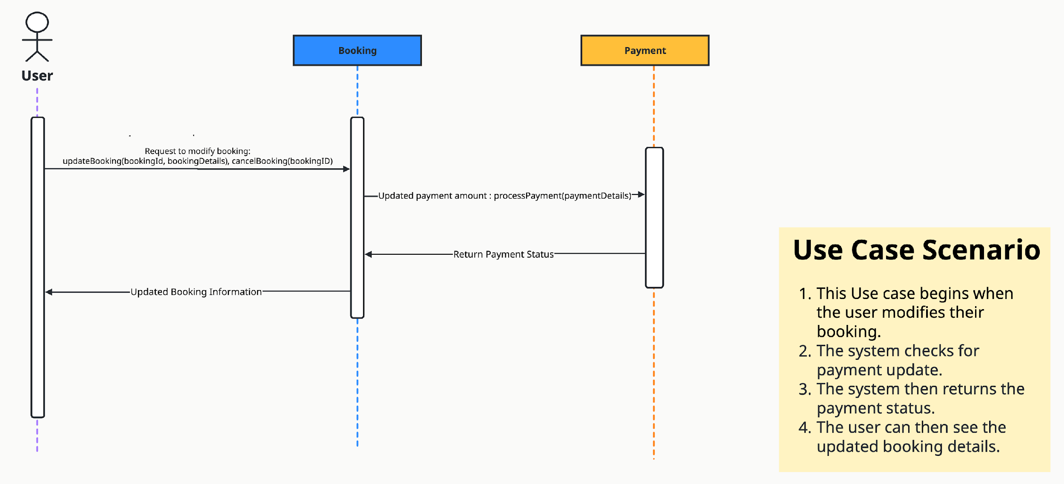
Sequence Diagram - Team 1
User Story: 03.03 Manage Bookings

Slide 2
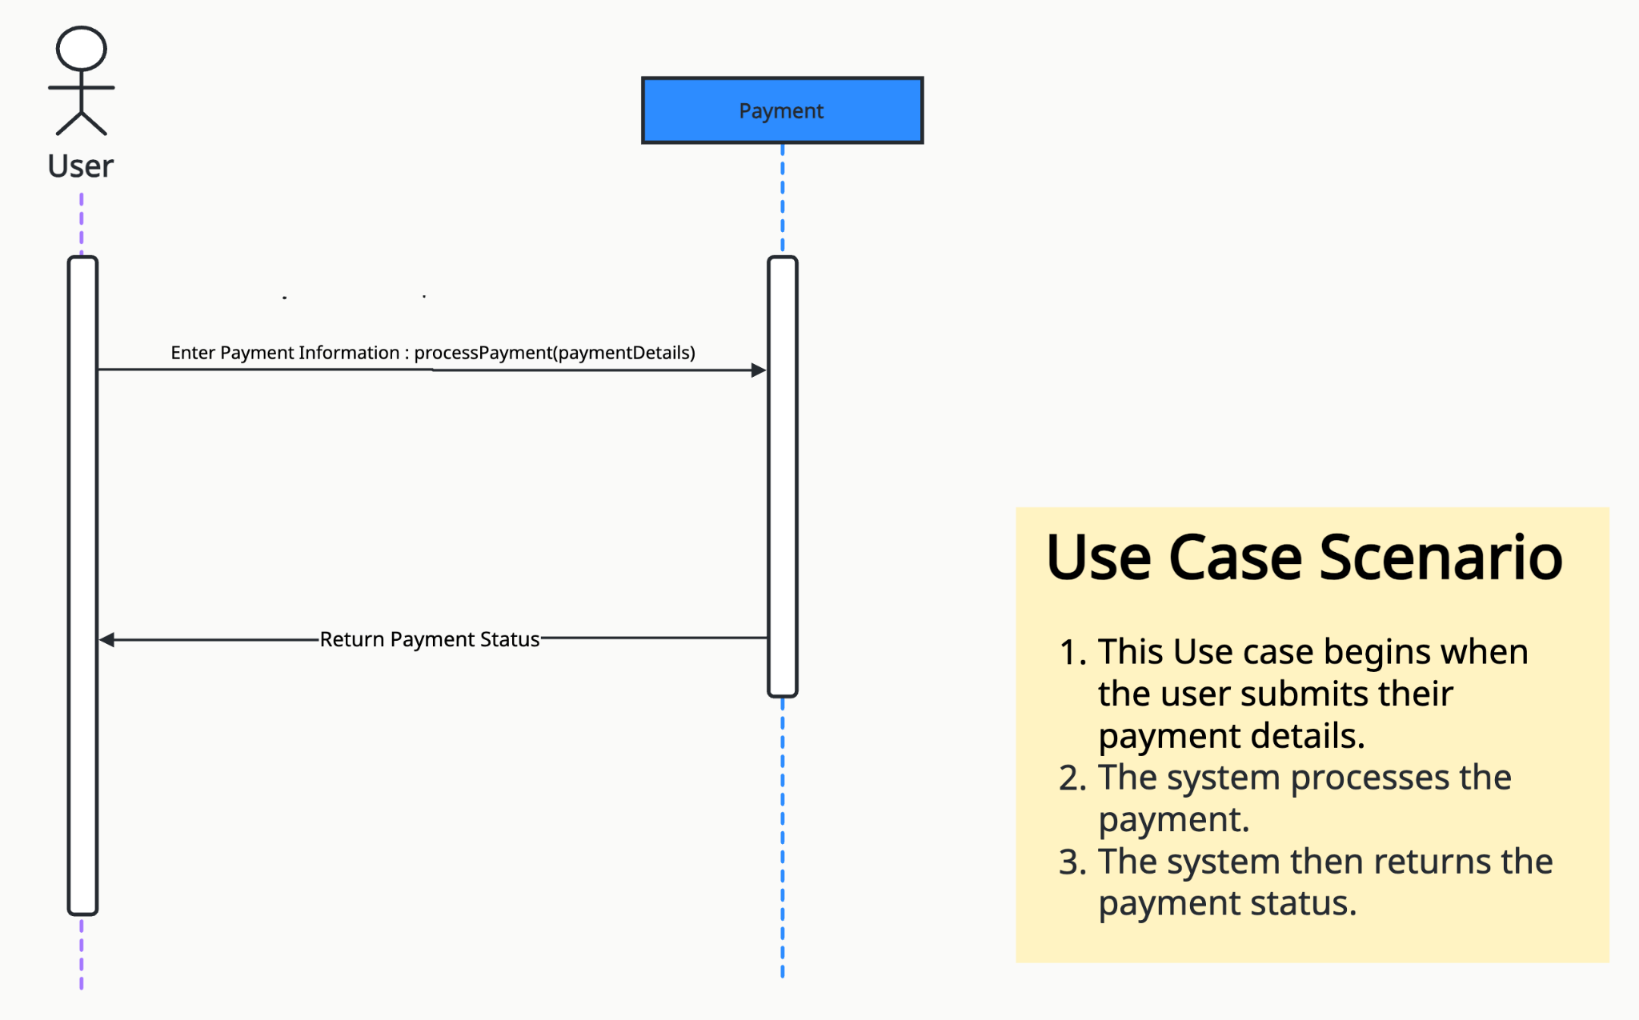
Sequence Diagram - Team 1
User Story: 04.01 Process Payments

Slide 3
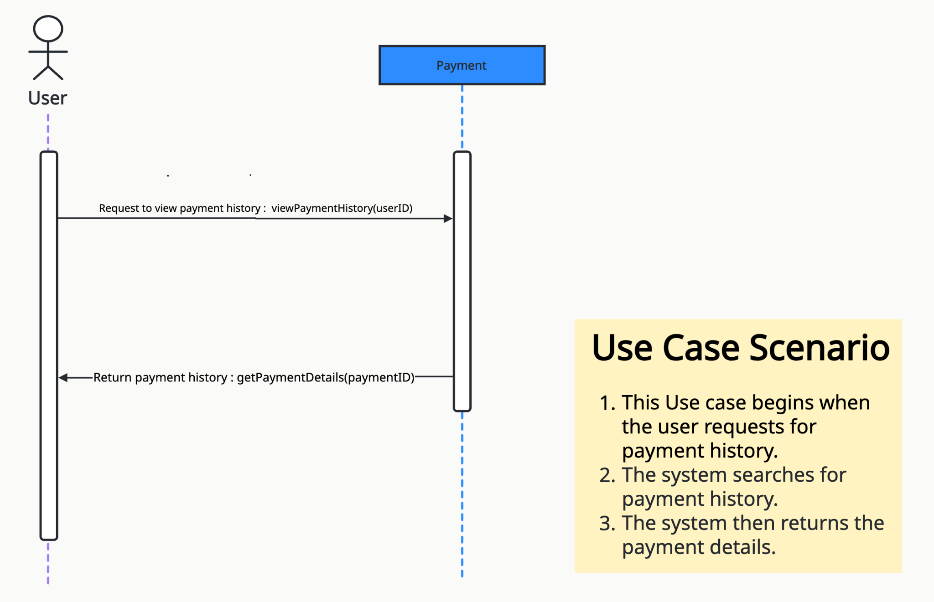
Sequence Diagram - Team 1
User Story: 04.02 View Payment History

Slide 4
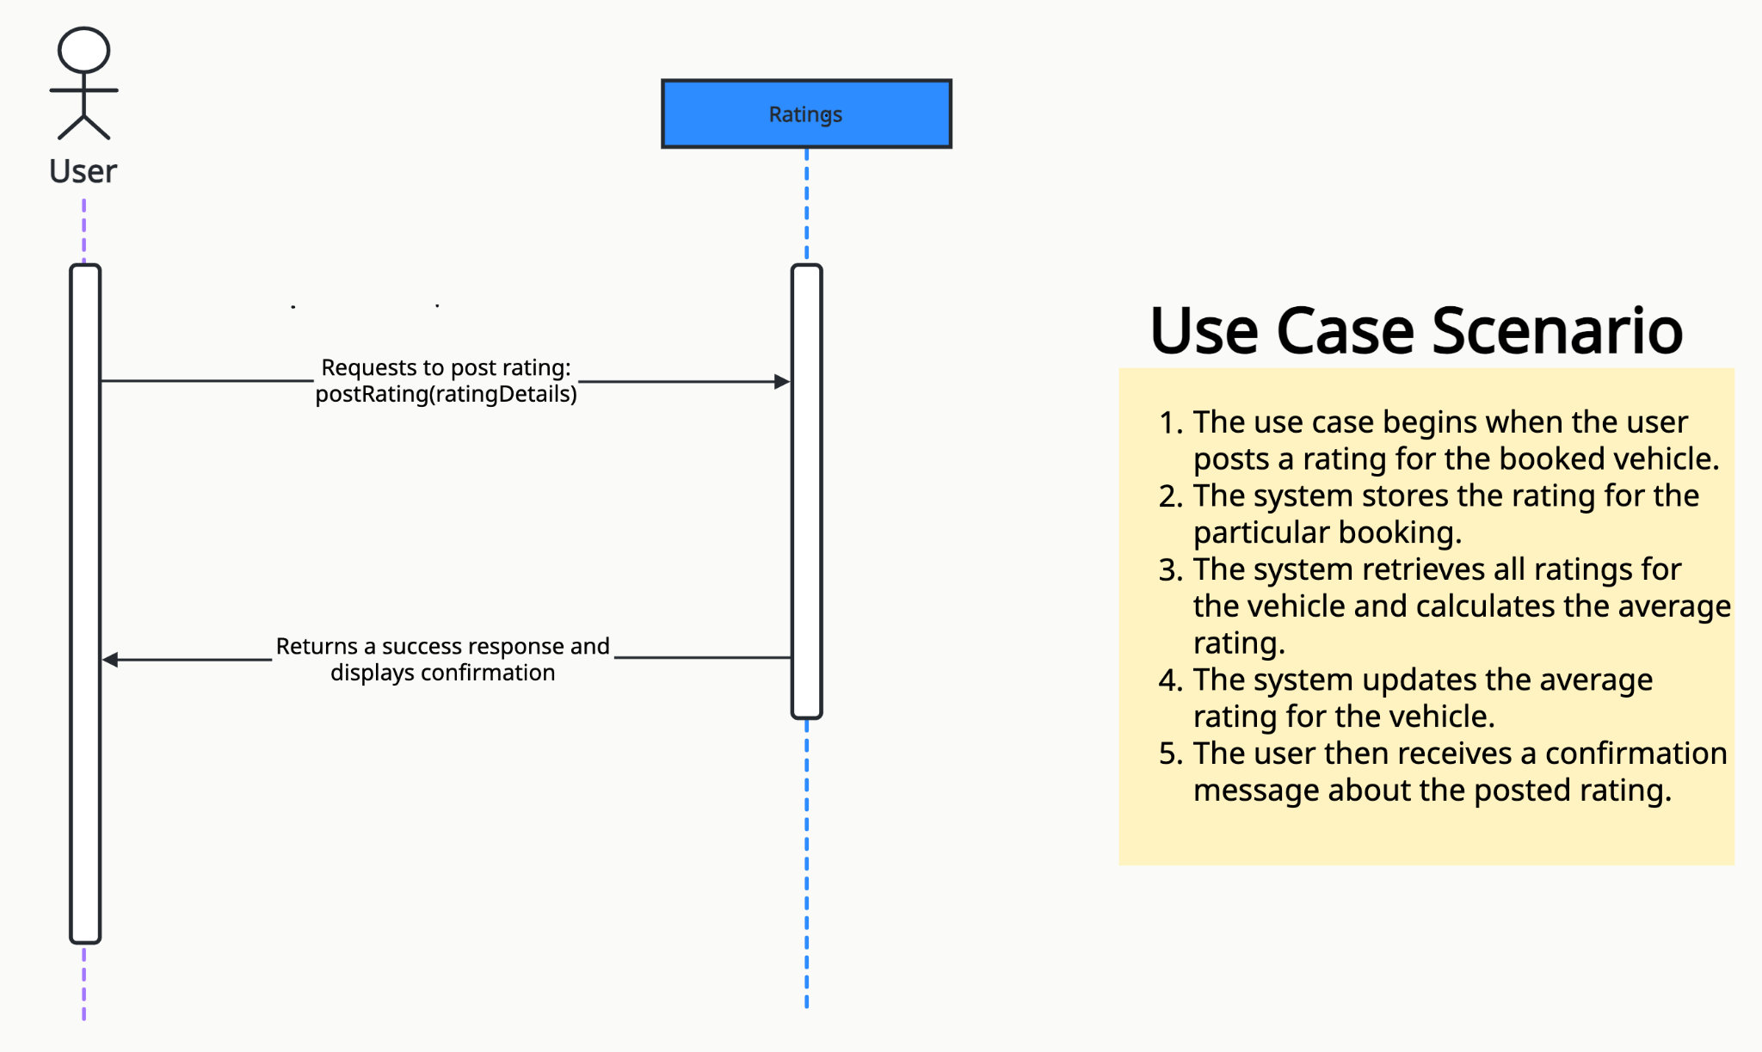
Sequence Diagram - Team 1
User Story: 04.03 Post Rating/Review

Slide 5
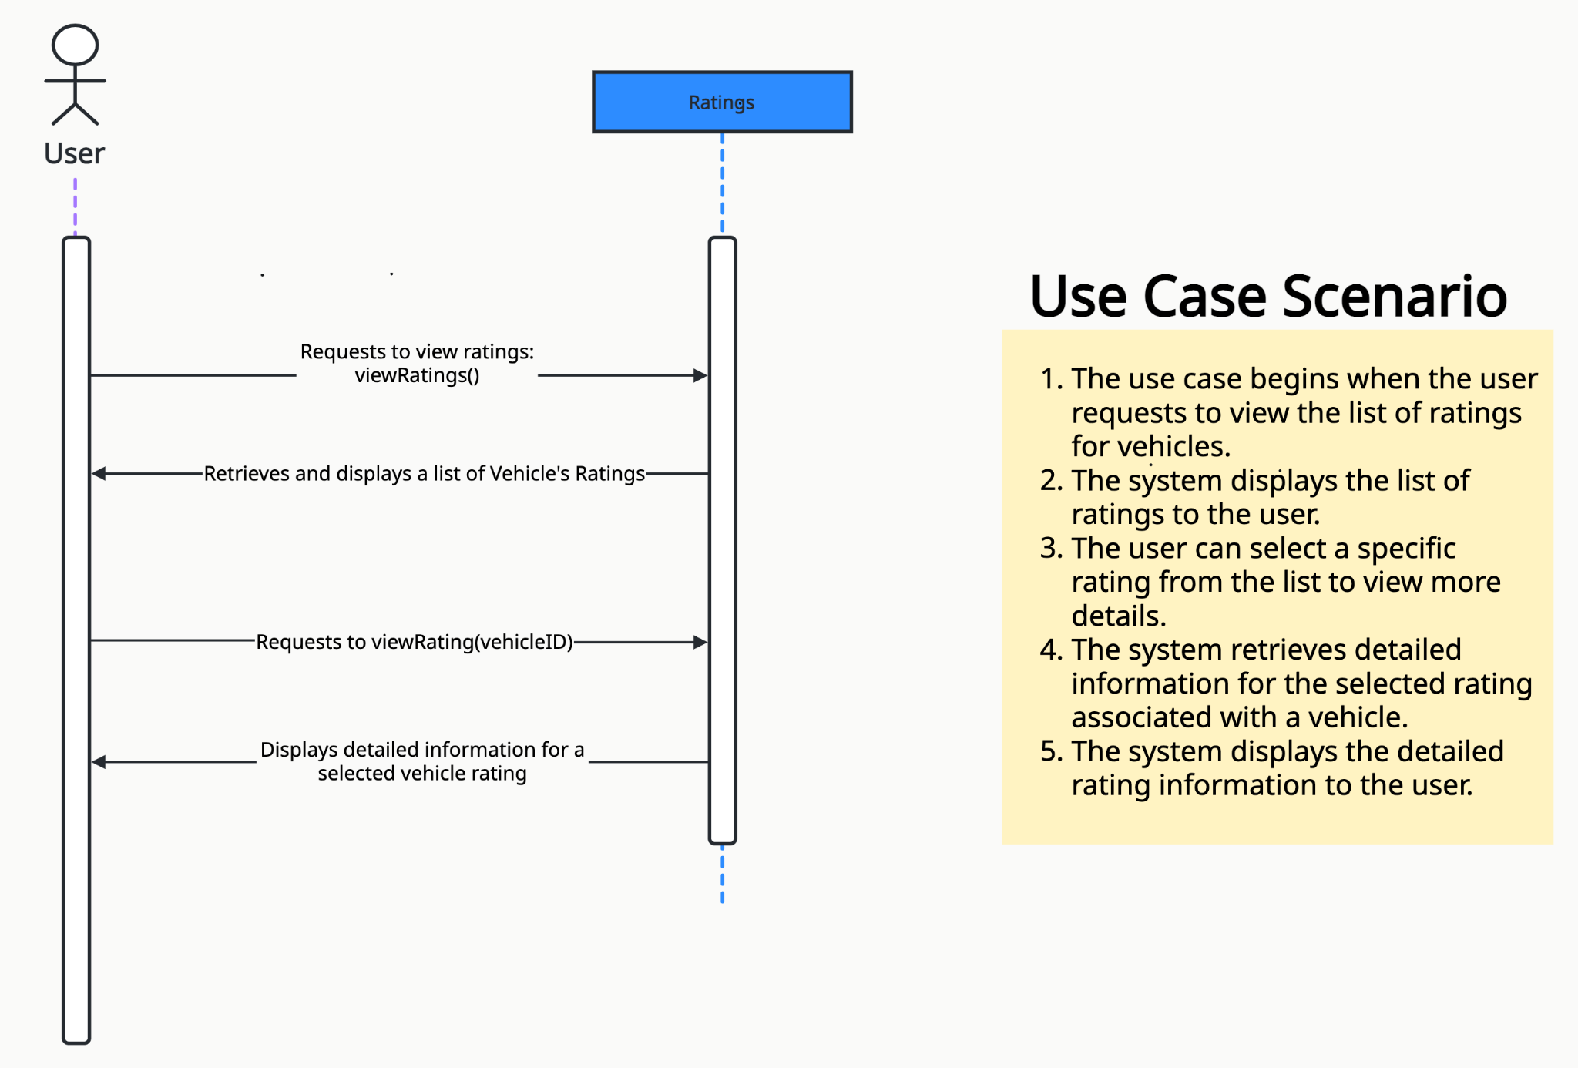
Sequence Diagram - Team 1
User Story: 04.04 View Ratings

